Slide 1



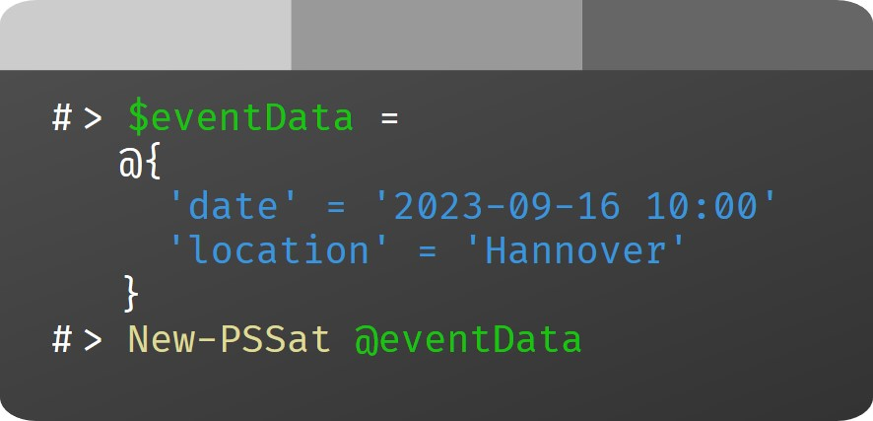
Notes:
PowerShell Saturday Hannover 2023
https://pssat.de

Slide 2



# > Get-Session
Title
-----
Eine Paketverwaltung für Windows
(Eine Geschichte voller
Missverständnisse)
# > Get-Speaker
Name Enabled SocialMedia ---- ------- -----------
Andreas Nick True @nickinformation
Thorsten Butz True @thorstenbutz
Notes:
Eine Paketverwaltung für Windows (Eine Geschichte voller Missverständnisse)
Andreas Nick & Thorsten Butz
about_Session
Mit der AppInstaller CLI (aka WinGet) hat Microsoft die Tor zu einer Paketverwaltung für Windows aufgestoßen. Schon der eigentümliche Name scheint ein Signal zu sein, wie schwer sich Microsoft tut, seine Plattform für eine zeitgerechte Form der Softwareverwaltung neu aufzustellen. Und über der Frage des Paketmanagements schwebt die noch grundsätzlichere Frage des Paketformats: MSIX und artverwandte “modern apps” tun sich schwer, die angestaubten Klassiker wie MSI vom Thron zu stoßen.
Wir lernen mit Scott Hanselman, Keivan Beigi und Demitrius Nelon die Protagonisten eines langjährigen Feldversuchs kennen, fremde Welten zu entdecken, neue Formate und neue Plattformen zu etablieren und Wege zu beschreiten, die nie ein Admin mitgegangen ist.
Andreas Nick und Thorsten Butz werfen einen launigen Insider-Blick auf Microsofts Ringen um eine Paketverwaltung und deren langen Weg vom Nano-Server (!) über Argument Completer hin zu nativen PowerShell-Cmdlets.
https://pssat.de/session/andreasnickthorstenbutz/

Slide 3



Starring
Notes:
Von links nach rechts:
Keivan Beigi
Demitrius Nelon
Scott Hanselman

Slide 4
Was bisher geschah ..

Slide 5

PackageManager (Beispiel)
DPKG initial release: January 1994 https://en.wikipedia.org/wiki/Dpkg
APT initial release: March 1998 https://en.wikipedia.org/wiki/APT_(software)

Slide 6

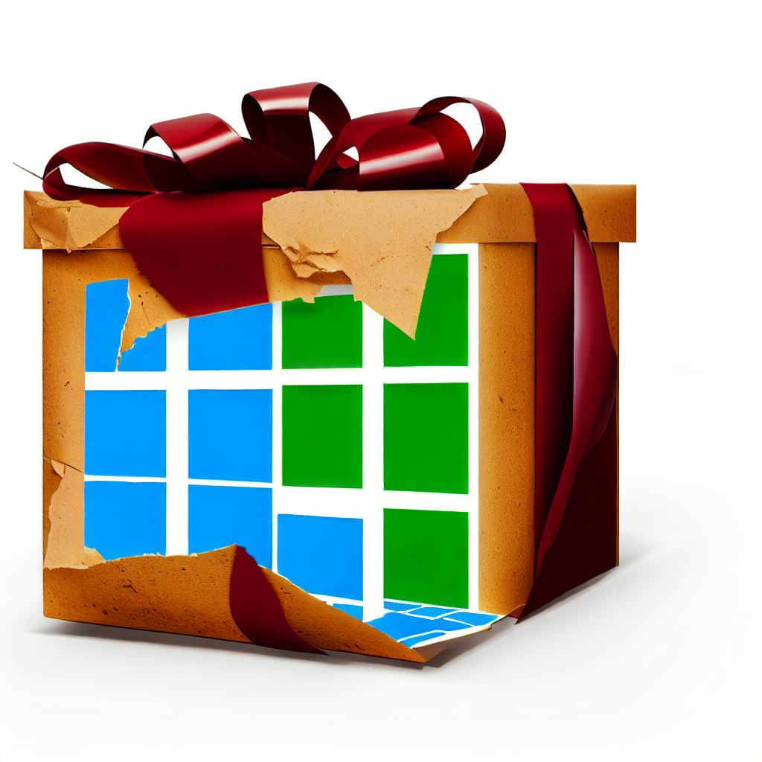



Windows PackageManagement?

Slide 7
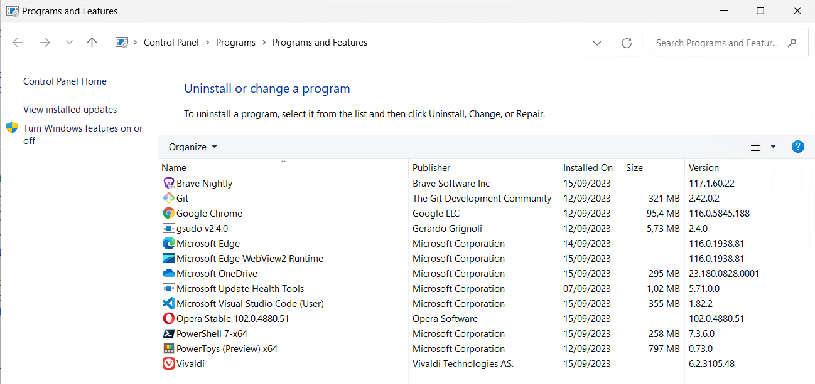
HKLM:\Software\Microsoft\Windows\CurrentVersion\Uninstall\*
Notes:
function Get-SoftwareInventory {
[CmdletBinding()]
[Alias('gswi')]
Param (
[Parameter(Mandatory,ValueFromPipeline,ValueFromPipelineByPropertyName)]
[string[]] $Computername
)
Begin {
$MyInvocation.Line | Write-Verbose
$stopwatch = [System.Diagnostics.Stopwatch]::StartNew()
}
Process {
## GetSoftware, simplified
$code = {
$path = 'HKLM:\Software\Microsoft\Windows\CurrentVersion\Uninstall\*',
'HKLM:\Software\WOW6432Node\Microsoft\Windows\CurrentVersion\Uninstall\*'
Get-ItemProperty -Path $path | Where-Object -Property DisplayName
}
Invoke-Command -ComputerName $Computername -ScriptBlock $code |
Select-Object -Property DisplayVersion,DisplayName,PSComputername #,UninstallStrin
}
End {
$stopwatch.Stop()
'Runtime(ms): ' + $stopwatch.ElapsedMilliseconds | Write-Verbose
}
}

Slide 8
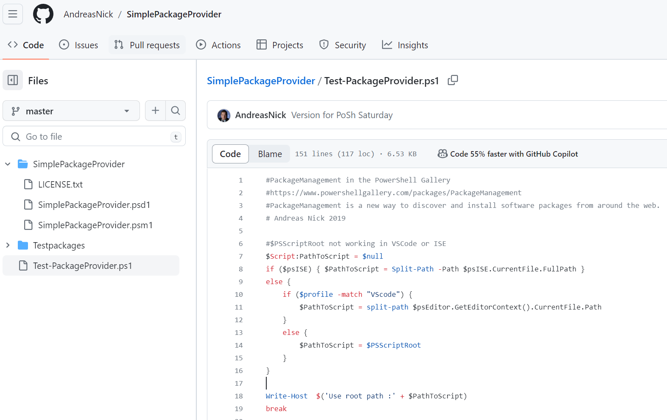
PackageManagement (aka OneGet)
What is PackageManagement (OneGet)?
OneGet is a Windows package manager, renamed as PackageManagement. It is a unified interface to package management systems and aims to make Software Discovery, Installation, and Inventory (SDII) work via a common set of cmdlets (and eventually a set of APIs). Regardless of the installation technology underneath, users can use these common cmdlets to install/uninstall packages, add/remove/query package repositories, and query a system for the software installed.
https://github.com/OneGet/oneget#what-is-packagemanagement-oneget
Notes:
https://github.com/OneGet/oneget

Slide 9
Announcement
This module is currently not in development. We are no longer accepting any pull requests to this repository. OneGet is in a stable state and is expected to recieve only high-priority bug fixes from Microsoft in the future.
Alternatively, we would suggest looking at the community AnyPackage project as an actively developed replacement for OneGet.
https://github.com/OneGet/oneget#announcement
Notes:
https://github.com/OneGet/oneget

Slide 10
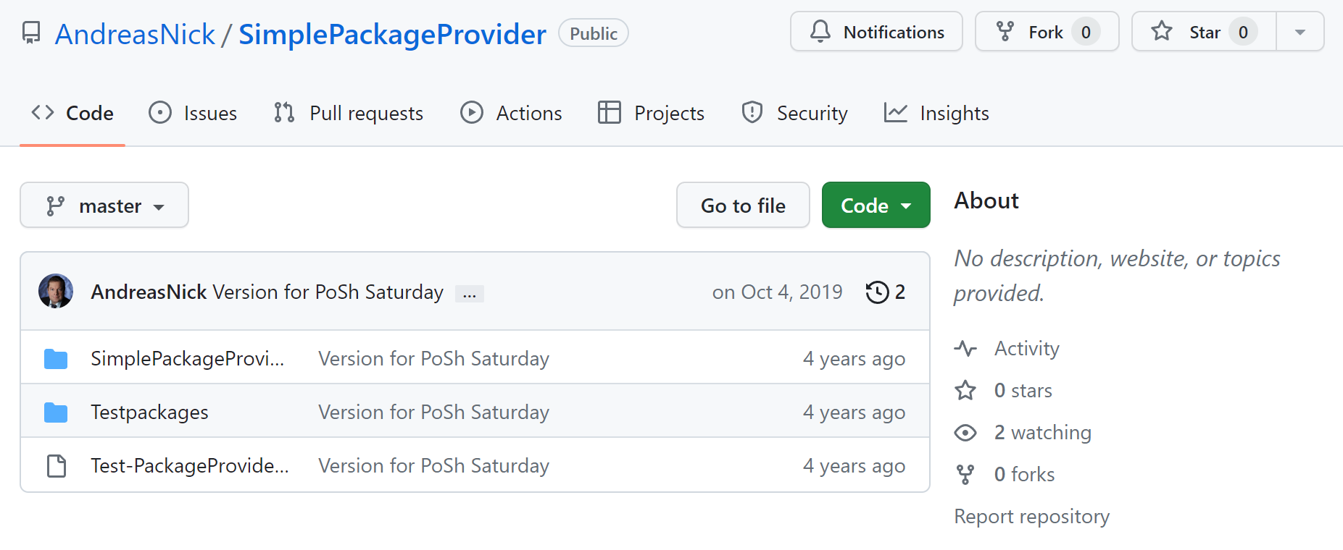
OneGet
Notes:
https://github.com/AndreasNick/SimplePackageProvider

Slide 11
Demo A
Notes:
Scoop demo

Slide 12
about_ModernApps

Slide 13


Application Virtualization
Notes:
https://en.wikipedia.org/wiki/Microsoft_App-V

Slide 14
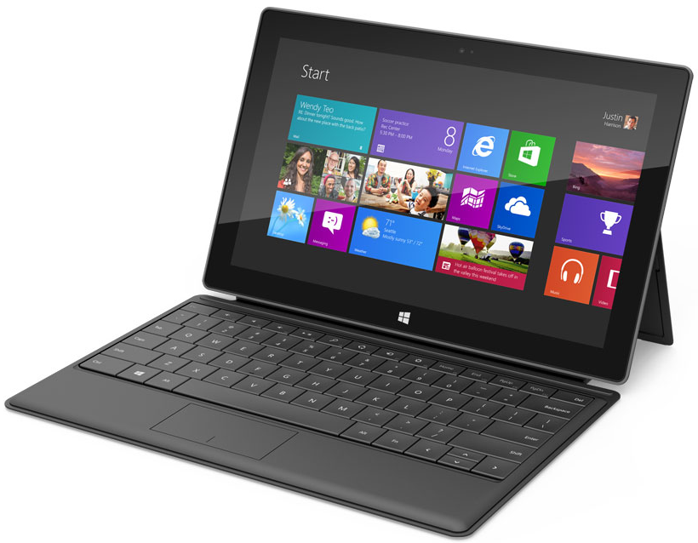
Windows 8
2012 Surface RT/ Surface Pro
2013 Surface 2 (RT)/ Surface Pro 2

Slide 15
Demo B
Notes:
Windows 10 MSIX packaging environment

Slide 16
about_WinGet

Slide 17
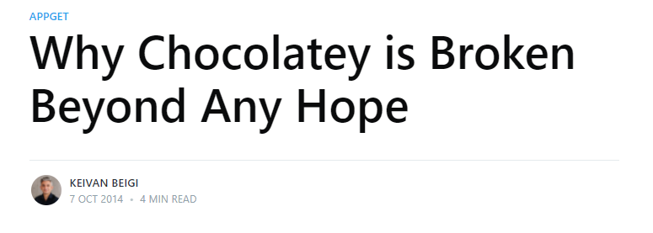
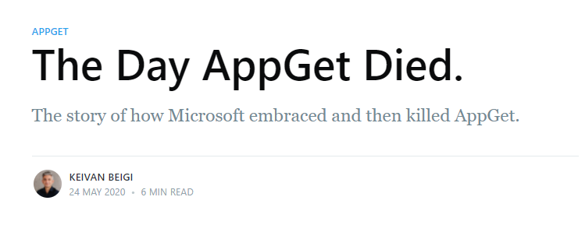
Keivan Beigi
https://keivan.io/why-chocolatey-is-broken
https://keivan.io/the-day-appget-died
Notes:
http://slidingwindows.de/slw18

Slide 18
Scott Hanselmann
Rename-Item
-Path AppInstallerCLI.exe
-NewName WinGet.exe

Slide 19

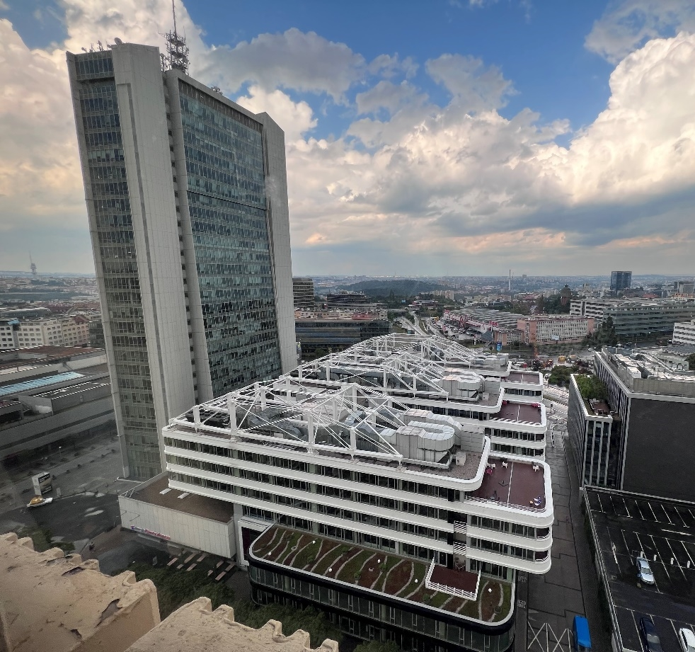


Episode 20
Winget with Demitrius Nelon
Recorded in Praha (Prague) on June 22, 2023
Notes:
Sliding Windows, Episode 20
Demitrius about the WinGet.Client module (in June 2023)
https://slidingwindows.de/slw20
# Begin
https://vimeo.com/853953408#t=1h4m4s
https://vimeo.com/853953408/aa4f0fd6e6#t=1h4m4s
# End
1h5m47

Slide 20
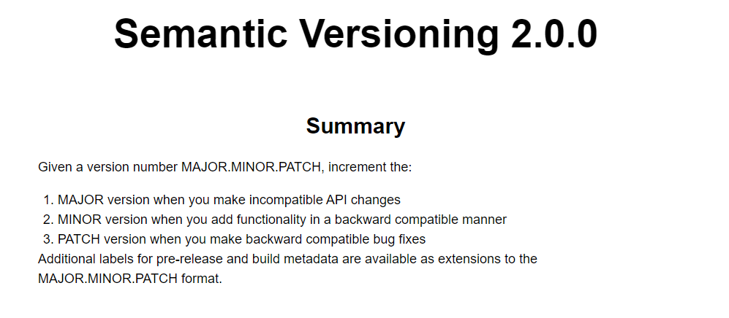
https://semver.org/spec/v2.0.0.html
Notes:
Semantic Versioning: Introduction
In the world of software management there exists a dreaded place called “dependency hell.” The bigger your system grows and the more packages you integrate into your software, the more likely you are to find yourself, one day, in this pit of despair.
[..]
As a solution to this problem, we propose a simple set of rules and requirements that dictate how version numbers are assigned and incremented. These rules are based on but not necessarily limited to pre-existing widespread common practices in use in both closed and open-source software. For this system to work, you first need to declare a public API. This may consist of documentation or be enforced by the code itself. Regardless, it is important that this API be clear and precise. Once you identify your public API, you communicate changes to it with specific increments to your version number. Consider a version format of X.Y.Z (Major.Minor.Patch). Bug fixes not affecting the API increment the patch version, backward compatible API additions/changes increment the minor version, and backward incompatible API changes increment the major version.
We call this system “Semantic Versioning.” Under this scheme, version numbers and the way they change convey meaning about the underlying code and what has been modified from one version to the next.
[..]

Slide 21

Demo C
Notes:
WinGet (aka AppInstallerCLI)

Slide 22
about_Future

Slide 23
Readme
Andreas@YT: https://www.youtube.com/@MADDay-pz8sb/videos
https://www.nick-it.de/blog/msix/msix-und-appx-pakete-mit-powershell-von-der-kommandozeile-starten
https://www.nick-it.de/blog/msix/msix-packaging-tool
https://www.nick-it.de/blog/app-v/msix-tutorial-ein-umfassender-leitfaden-mit-24-kapiteln
https://github.com/AndreasNick/SimplePackageProvider
https://msixhero.net/
WinGet – behind the scenes (English video) https://www.thorsten-butz.de/winget-dupsug/
Hinter den Kulissen von WinGet (PSUG Hannover) https://www.thorsten-butz.de/winget/
Interview Demitrius Nelon (Sliding Windows 20) https://www.slidingwindows.de/slw20
Inverview Keivan Beigi (Sliding Windows 18) https://www.slidingwindows.de/slw18
Codebeispiele, Folien https://github.com/thorstenbutz/conferences https://github.com/AndreasNick
Notes:
https://www.nick-it.de
https://www.thorsten-butz.de
https://www.psugh.de
https://pssat.de

Slide 24
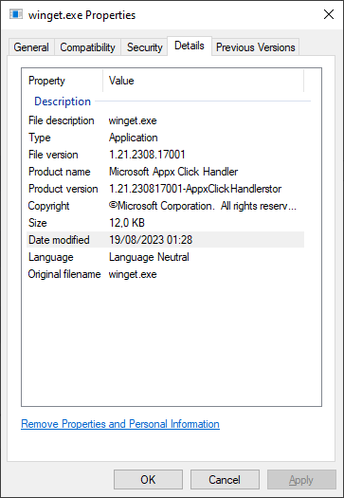
Versioning is not a problem *
Windows Package Manager Version numbers (2023-09-06)
winget.exe --info | v1.6.2291-preview
Get-AppxPackage | 1.21.2291.0
Get-AppxProvisionedPackage | 2023.817.2326.0
File version (AppInstallerCli.exe) | 1.21.2308.17001
Latest stable release | 1.5.2201
" Versioning is not a problem. Problems can be solved. " (Jeffrey Snover)
Notes:
winget.exe –version (short info)
winget.exe --info (detailed info)
Get-AppxPackage -Name Microsoft.DesktopAppInstaller
Get-AppxProvisionedPackage -Online |
Where-Object -Property DisplayName -eq
-Value Microsoft.DesktopAppInstaller
Get-Item "$home\AppData\Local\Microsoft\WindowsApps\*"

